Slide 1
Chapter 13

Slide 2
Objectives

Slide 3
An iterative function that loops infinitely

Slide 4
A recursive function that loops infinitely

Slide 5
An iterative function

Slide 6
Code that calls the add_numbers() function

Slide 7
How to calculate the factorial of a number

Slide 8
A recursive function that calculates the factorial of a number

Slide 9
An iterative function that calculates the factorial of a number

Slide 10
The Fibonacci series

Slide 11
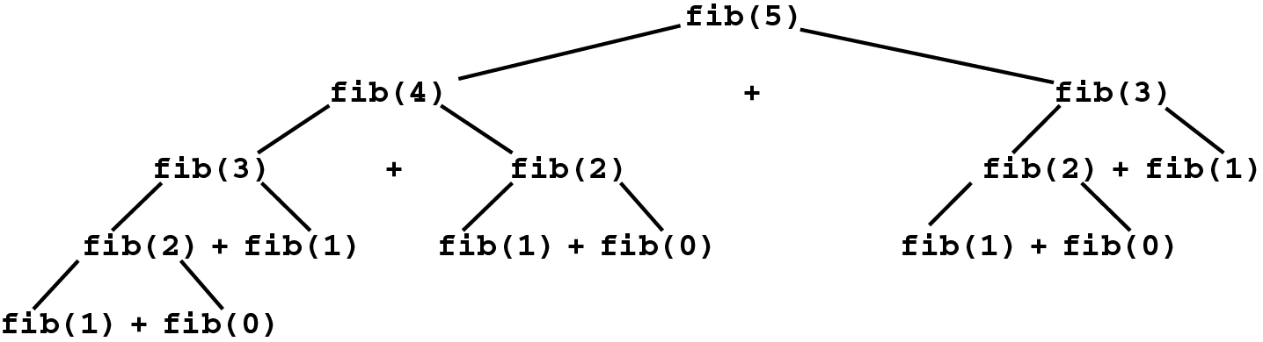
The tree of function calls that calculate the 5th number in the series

Slide 12
An iterative function that computes a Fibonacci sequence

Slide 13
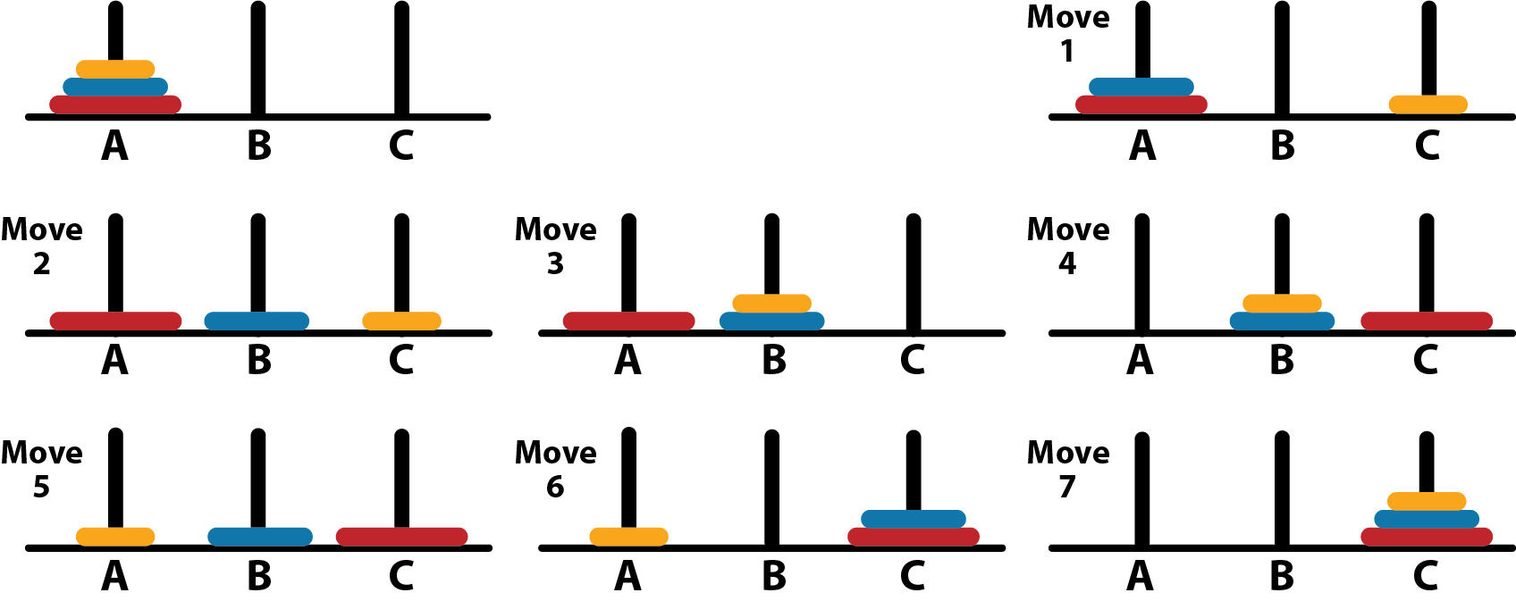
How to solve the Towers of Hanoi puzzle with 3 disks

Slide 14
The rules

Slide 15
A recursive algorithm for solving the puzzle

Slide 16
The user interface

Slide 17
The code

Slide 18
The pattern for 4 disks (15 moves)

